Slide 1
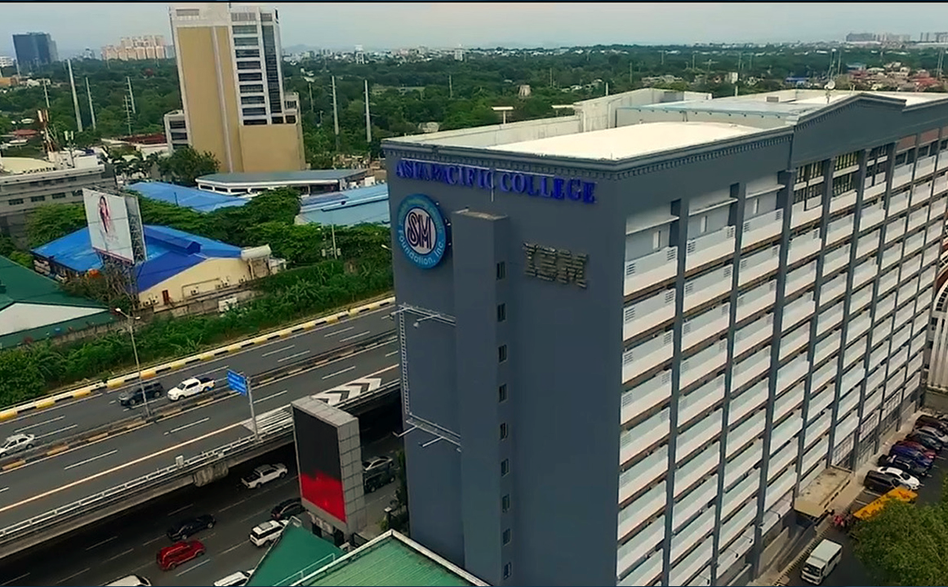



S S
TEM
802-GO :
Barangay Management System
by SISTEM
Notes:
Eddie

Slide 2






SISTEM
S S
TEM
Ryan John Perez
Adviser
Jose Enrique Nunez
Jhon Iberson Marinas
Joana Grace Garcia
Allan Miguel Moldez
Hazel Ann Mones
Project Leader
E

Slide 3
Overview
S S
TEM
1
4
Project Overview
GitHub Repository
2
5
Cloud Hosted Prototype
Comments Matrix
3
Entity Relationship Diagram
6
Member Contributions
K

Slide 4

S S
TEM
Project Overview
Barangay 802, Sta Ana, Manila City

Slide 5
For: | The Barangay officials, residents, businesses, and community organizations in Barangay 802 Sta. Ana, Manila City.
Who: | Encounter challenges in service provision and access, communication, and resident engagement.
The: | 802-GO is a centralized digital platform.
That: | Enhances service access, communication, and community engagement.
Unlike: | Conventional Barangay Systems.
Our Product: | Provides a user-friendly, one-stop website that empowers residents, supports local businesses, streamlines governance.
S S
TEM
Product
Vision
V

Slide 6
S S
TEM
Comments Matrix
SISTEM | 802 - GO

Slide 7
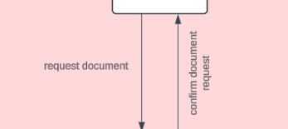
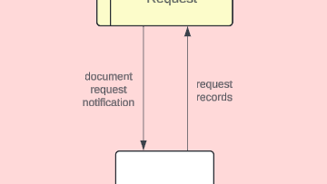
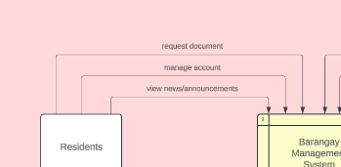
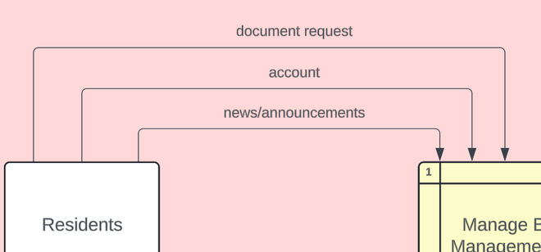
DFD Comments Matrix
Panelist | Comment | Response
Ms. Gardon | Flow line text indicators should always be horizontal, not vertical. | Adjusted the diagram to ensure all flow line text indicators are horizontal.
Ms. Gardon | Flow line text indicators must be data. | Updated all flow line text indicators to be “data”, ensuring they are aligned with the required format.
S S
TEM

Slide 8
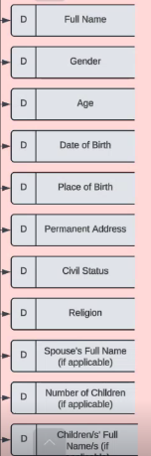
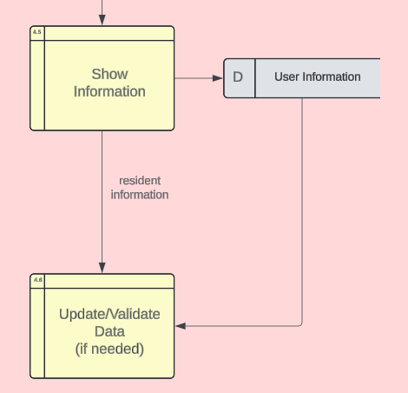
DFD Comments Matrix
Panelist(s) | Comment | Response
Ms. Gardon & Ms. Valbuena | Data stores can be reduced to 1 and Generalized data store. And that, the Multiple Data Stores are not required in Data Flow Diagram. This can be specified on when creating the ERD. | Consolidated multiple data stores into a single, generalized data store to simplify the diagram.
S S
TEM

Slide 9
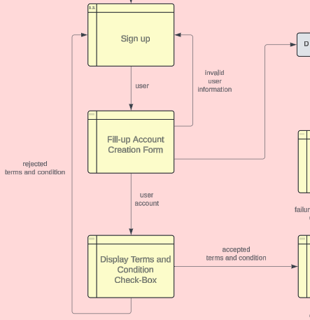
DFD Comments Matrix
Panelist | Comment | Response
Mr. Gumogda | Level 1 DFD Cash Donation: If not in scope of the system, it should not be included. | We removed the Cash Donation on the DFD because Barangay doesn’t require payments for their services.
Mr. Gumogda | Level 2 DFD Token Access Denied Message: Create a checkbox instead so that the resident will not be able to move on to the process until the checkbox is ticked. | We merged the process of the Terms and Condition to remove the confusion and create an improved visual of the process for the Diagram.
S S
TEM

Slide 10
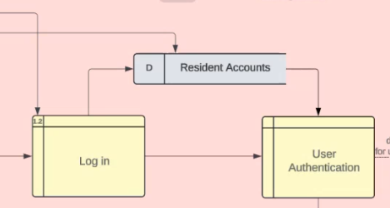
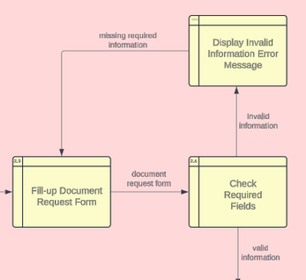
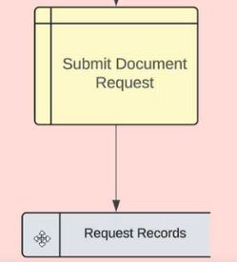
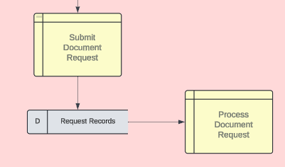
DFD Comments Matrix
Panelist | Comment | Response
Ms. Valbuena | There are so many Arrows that doesn’t have a description. Example: | We revised the diagram and included the data that flows through in and out of the processes and data stores.
Ms. Valbuena | Level 1 Process 2 Request of Documents: The Request records data store is only saving the request and no other process one is retrieving the data that was stored. | Data that flows through the process and Data Store will be named. We revised the Diagram so that there is a process that needs the data from the data store where the request of the residents is saved.
S S
TEM

Slide 11
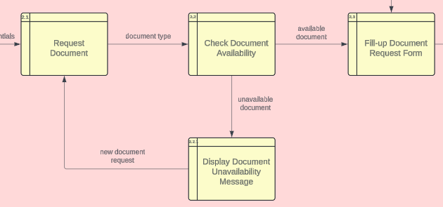
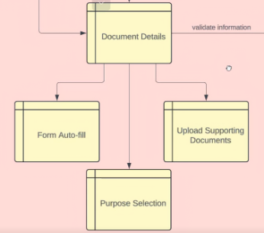
DFD Comments Matrix
S S
Panelist | Comment | Response
Ms. Valbuena | DFD, Level 1 Process 2 Request documents: No data flow from the 3 processes under the Document details and shows that one process goes to three right away. The processes also doesn’t have a number so it’s hard to distinguish if the following processes are inside of one or not. | Addition of data that flows from the processes. Addition of process numbers e.g., 2.3 under that is 2.3.1, 2.3.2, 2.3.3 [...].
TEM

Slide 12
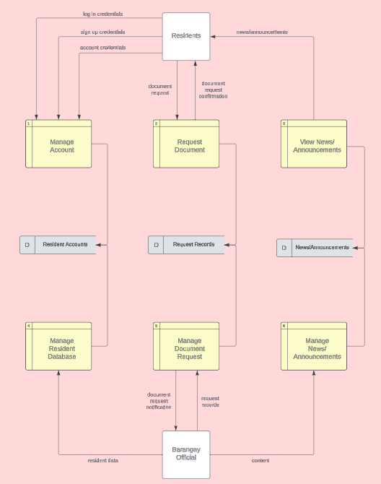
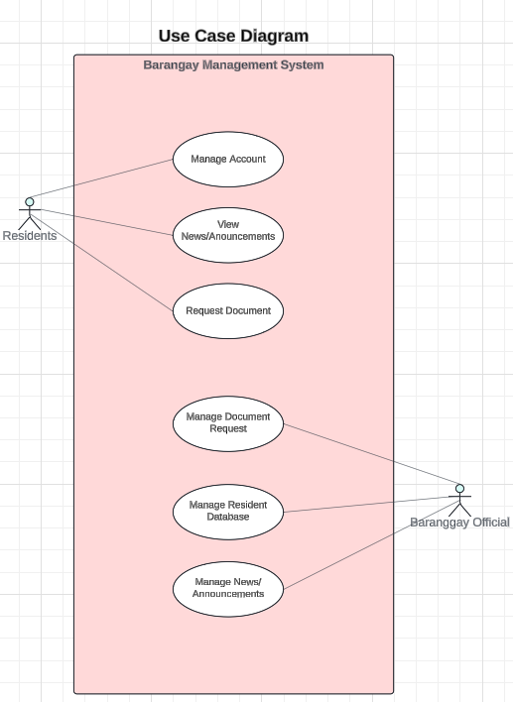
DFD Comments Matrix
Panelist | Comment | Response
Ms. Valbuena | Use Case names should also be the same name as DFD since it is connected, the same with the other diagrams to avoid confusion. | We revised the names of the processes on the Diagrams so that it will be connected to one another.
S S
TEM

Slide 13
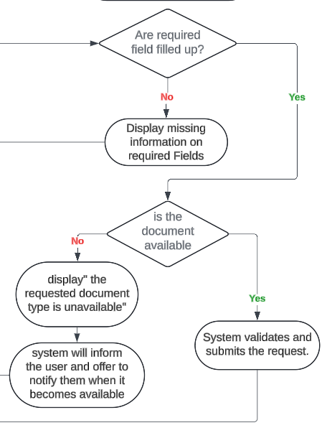
Activity Diagram Comments Matrix
Panelist | Comment | Response
Mr. Gumogda | Activity Diagram Manage Account: The decisions on the flow is confusing. | We changed the content of the “decision” to a “question” e.g., “ Is the user able to log in?” and will be answered by Yes and No, the process will go on.
S S
TEM

Slide 14
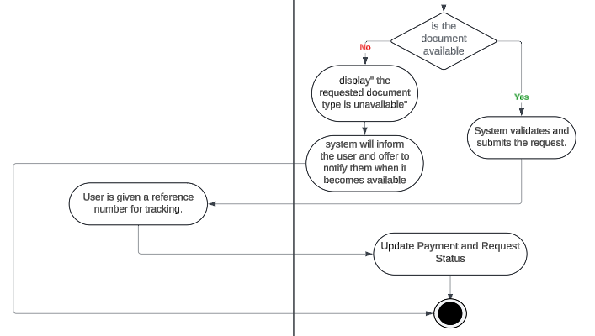
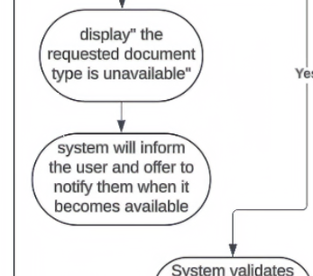
Activity Diagram Comments Matrix
S S
Panelist | Comment | Response
Ms. Valbuena | Activity Diagram: Request Document The flow shows a dead end where there is no process next after the system informs the user that they will be notified after the requested documents become available for pick up. | Addition of next flow on the process until it reaches the end of the activity.
TEM

Slide 15
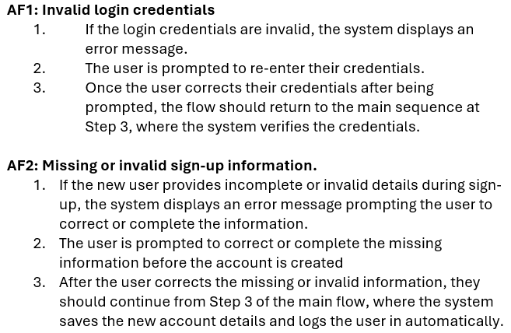
Fully-Dressed Use Case Comments Matrix
S S
TEM
Panelist | Comment | Response
Ms. Gardon | The alternate flow should contain only alternate routes which goes back to the main flow. | Revised the alternate flow to include alternate routes that leads back to the main flow, removing any unrelated details.

Slide 16
S S
TEM
Entity Relationship Diagram
SISTEM | 802 - GO

Slide 17
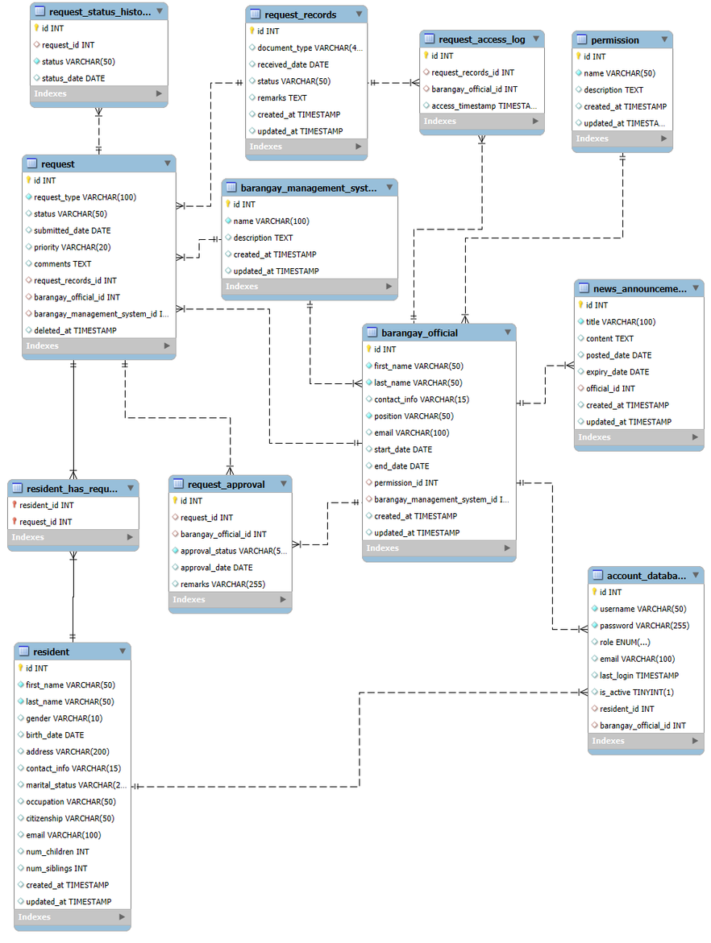
S S
TEM
Entity Relationship Diagram (ERD)

Slide 18
S S
TEM
Github Repository &
Cloud Hosted Prototype
SISTEM | 802 - GO

Slide 19
Contributions
S S
 | Documentation | Diagrams | Development
Joana Grace Garcia | Final Paper Presentation Deck | DFD Fully-Dressed Use Case Test Cases | Document Request Page
Jhon Iberson Marinas | Comment Matrix | Fully-Dressed Use Case Activity Diagram w/ Swimlanes ERD | About Us Section (Home Page)
Allan Miguel Moldez | Final Paper MOTMs | Use Case Diagram DFD Fully-Dressed Use Case | Homepage
Hazel Ann Mones | Final Paper Documentation Lead | DFD Fully-Dressed Use Case Test Cases | Log In and Register
Jose Enrique Nunez | Comment Matrix | Fully-Dressed Use Case Activity Diagram w/ Swimlanes ERD | Barangay Contact Section (Home Page)
TEM

